Slide 1
PIZZA SALES DATA

Slide 2
Performance Metrics (KPIs)

Slide 3





Total Revenue
Total Pizza Sold
Total Order
Avg Pizza Per Order
Avg Order Value

Slide 4
SALES & SEASONAL TREND

Slide 5
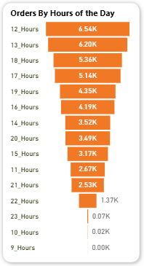

1. The chart indicates 12hrs as peak ordering hours
2. Average number of pizzas ordered per day?

Slide 6
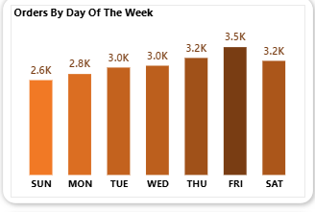
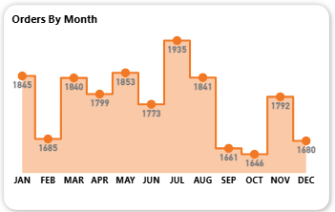
3. The highest order was placed on Fridays which contribute to the revenue. The Month of July has the highest order which contributes to the revenue as well.
Peak Sales Times: Orders are heavily concentrated From Thursday – Saturday during lunch hours (12PM - 1 PM).

Slide 7
Product Performance

Slide 8
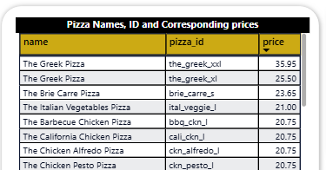
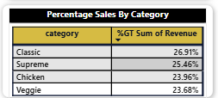
1. Base on category-wise distribution of pizzas sold, Classic has 26.91%, Supreme 25.46%, Chicken 23.96%, Veggie 23.68%
2. The most expensive pizza is “The Greek Pizza” whose price is $35.95 per unit?

Slide 9
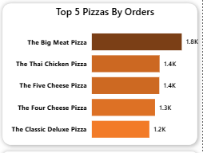
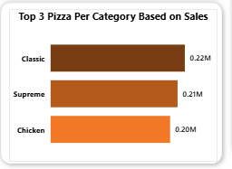
3. Top 5 best-selling pizzas by number of orders include: The Big Meat Pizza, The Thai Chicken Pizza, The Five cheese Pizza, The Four Cheese Pizza and the Classic Deluxe Pizza with 1.8k, 1.4k, 1.4k, 1.3k, 1.2k orders respectively.
4. The Top 3 pizzas per category based on sales are Classic, Supreme and Chicken categories.

Slide 10
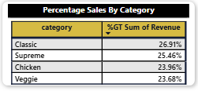
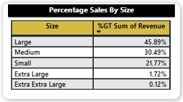
5. The percentage of sales which come from each category include: 26.91% for Classic, 25.46% for supreme, 23.96 for Chicken, 23.68% for Veggie. While percentage of sales for size include 45.89% for Large, 30.49% for Medium, 21.77% for Small, 1.72% for Extra large, and 0.12% for Extra_Extra large.

Slide 11
Key Findings
Peak Sales Times:Orders are heavily concentrated From Thursday – Saturday during lunch hours (12PM - 1 PM).
Bestselling Category: The Large size is the most popular, contributing the most to total revenue. The Big Meat and Thai Chicken are the top-selling pizzas.
Revenue Insights: A small number of pizza types (roughly 20%) generate the majority (around 80%) of the revenue, indicating a strong customer preference for core menu items.

Slide 12
Recommendations
1. Optimize Staffing & Operations: Ensure you are fully staffed with your best crew during peak weekend and dinner rushes to maintain service speed and quality.
2. Strategic Promotions:
  Upsell: Create combo deals to encourage upselling from Medium to Extra Large pizzas.
  Boost Off-Peak: Offer "Happy Hour" or lunch specials on slower weekdays to increase traffic.
3. Menu & Inventory Management:
  Feature Winners: Prominently feature the bestselling pizzas (The Bif Meat, The Thai Chicken, The five cheese) in marketing.
  Evaluate Low Performers: Consider removing the least-ordered pizzas to simplify operations and reduce inventory waste.

